Slide 1
Ada Boost Algorithm
Ada Boost Algorithm
It works same as normal boosting algorithm
Transforming weak learners into strong learners
By giving Incremental weights concept
Used for both classification and regression

Slide 2
AdaBoost, or Adaptive Boosting, is a popular ensemble method used in machine learning. It is a meta-algorithm that combines several weak learners to create a strong learner.
AdaBoost is particularly effective for binary classification problems, but it can also be applied to other types of problems. In this chapter, we will discuss the AdaBoost algorithm, its variants, and its application in machine learning.
AdaBoost
AdaBoost Algorithm
The AdaBoost algorithm is an iterative process that combines multiple weak classifiers to create a strong classifier.
The weak classifiers are typically simple decision trees or other types of classifiers that are trained on a subset of the data.
The AdaBoost algorithm assigns weights to each training example, with misclassified examples receiving higher weights. In the next iteration, the algorithm selects a new weak classifier and adjusts the weights of the training examples again.
This process is repeated until a predetermined number of classifiers have been created.

Slide 3
Advantages of AdaBoost
Can handle binary and multi-class classification problems.
Can handle noisy data and outliers.
Has a high degree of interpretability, since it relies on simple weak classifiers that can be easily understood.
Often results in high accuracy and outperforms other algorithms in many scenarios.
Disadvantages of AdaBoost
Sensitive to noisy data and outliers that are not properly preprocessed.
Can be computationally expensive, especially with large datasets.
Can lead to overfitting if the weak classifiers are too complex or if the number of boosting iterations is too high.
Requires careful parameter tuning to achieve optimal performance.

Slide 4
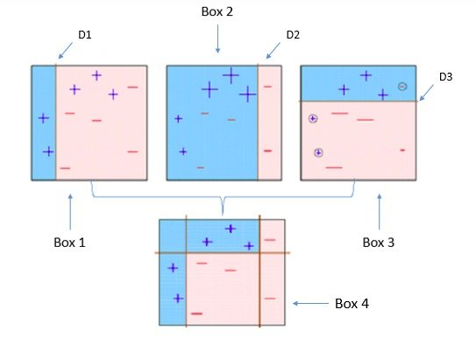

Slide 5
Ada boost follows Ensemble method in Machine learning.
Reassign weight to each instance
Higher weights for incorrectly classified
Reduce bias and Variance
Ada boost uses Stump as Base learners.
Root node
Stump
Leaf node
Leaf node

Slide 6
How boosting works
BL1,BL2,BL3 ARE BASE LEARNERS
BL1
BL2
BL3
Root node
O/P
Leaf node
Leaf node
Ada boost uses Stump as Base learners.
STUMP

Slide 7
ADA Boost with example
Row no | A,B,C | 0UTPUT | SAMPLE WEIGHT
1 | Categorical data | Y | 1/5
2 | Categorical data | Y | 1/5
3 | Categorical data | N | 1/5
4 | Categorical data | N | 1/5
5 | Categorical data | Y | 1/5
W=1/N,
Where N= No of observations,
here no of rows =5, so N=1/5
Notes:
W=1/N, Where N= No of observations, here no of rows =5, so N=1/5

Slide 8
Step 1: Creating first Base Learner
A
F1
B
F2
C
F3
Row No | A,B,C | OUTPUT | SAMPLE WEIGHT
1 | Categorical data | Y | 1/5
2 | Categorical data | Y | 1/5
3 | Categorical data | N | 1/5
4 | Categorical data | N | 1/5
5 | Categorical data | Y | 1/5
Here in this F1,F2,F3, we need to take the best stump, using entropy and gini index
In this table we know that except the 2 row all are correct, but the 2 row is having misclassified samples

Slide 9
Step 2: Calculate the total error
Total Error (TE) = 1/5
Step 3: Calculate the performance of the stump
Performance of the Stump= 1\2 l_{n} (1-T_{e} )/T_{e} =1\2l_{n} (1-1/5)/1/5=0.693

Slide 10
Step 4: Updating the weights
This is for misclassified data weight
New Sample Weight = Sample weight * e^{(Performance)}
= 1/5 * e ^{0.693}
=0.399
So for correct----> Classified data weight
New Sample weight = Sample weight * e ^{–(performance)}
= 1/5 * e^{-(performance)}
= 0.100

Slide 11
So, we can update the above values in the Table
If we sum this update weight it should be give the result as 1, but here it gave the result as 0.799.
But, while checking in Normalized weight it gives the result as 1
Row No | A,B,C | OUTPUT | SAMPLE WEIGHT | UPDATE WEIGHT | NORMALIZED WEIGHT
1 | Categorical data | Y | 1/5 | 0.1 | 0.13
2 | Categorical data | Y | 1/5 | 0.399 | 0.50
3 | Categorical data | N | 1/5 | 0.1 | 0.13
4 | Categorical data | N | 1/5 | 0.1 | 0.13
5 | Categorical data | Y | 1/5 | 0.1 | 0.13
 |  |  |  | 0.799 | 1
So, we are going to split the Normalized weight into Buckets
Total

Slide 12
Here, we are going to split the Normalized weight into Buckets
By
Creating New Dataset
Normalized Weight | Buckets
0.13 | 0 – 0.13
0.50 | 0.13 –0.63
0.13 | 0.63 – 0.76
0.13 | 0.76 – 0.89
0.13 | 0.89 – 1.02
While iterating our data, and if we take for example random value = 0.40
It comes under the 2 row -→ which comes under the misclassified .
So, by doing many iterations → misclassified data will be replaced, and it will build a strong model with low bias and variance.

